Slide 1
Lecture 01: Introduction to Microcomputer & Embedded Systems

Slide 2
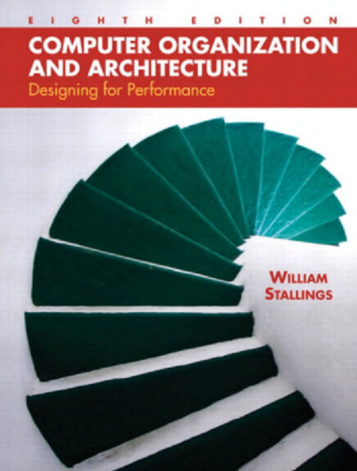
Reference Book:
William Stallings Computer Organization and Architecture
Chapter 1 & 2
微型计算机原理与接口技术（第四版）
第一章

Slide 3
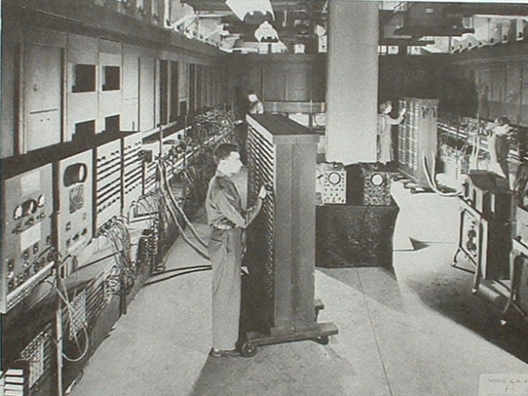
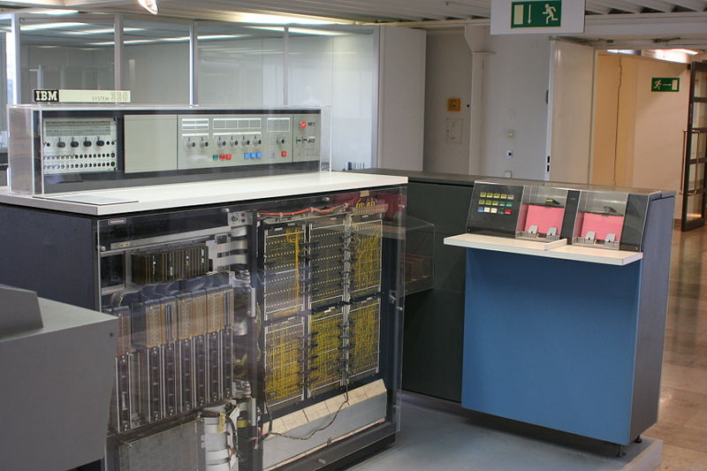
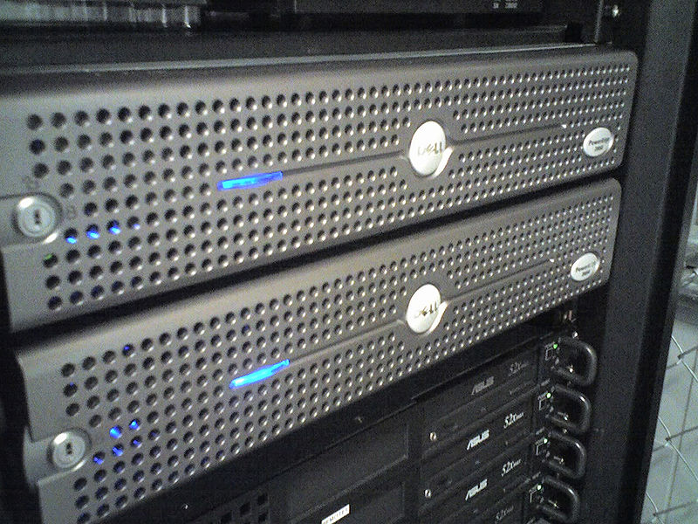
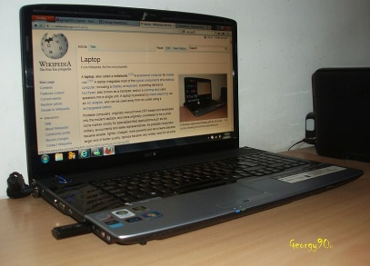
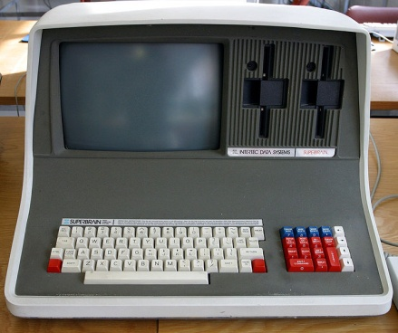
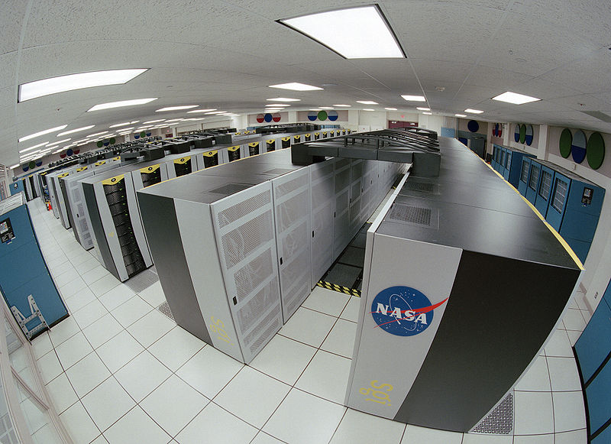
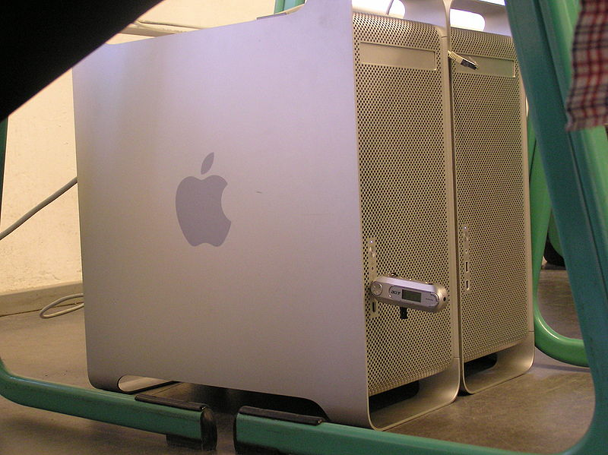
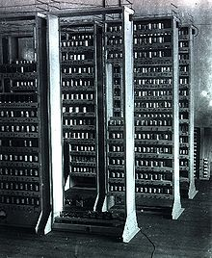
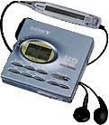
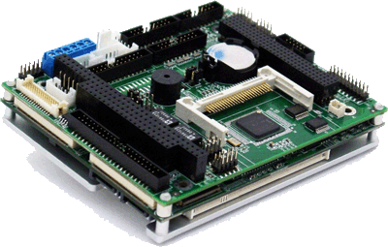
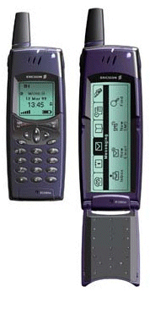
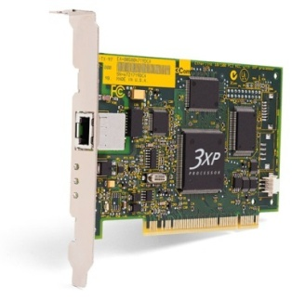
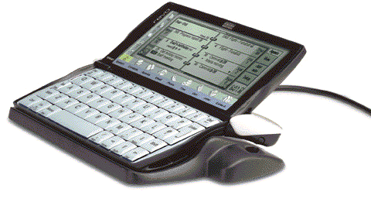

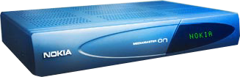
What is a computer?

Slide 4
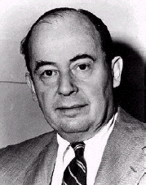
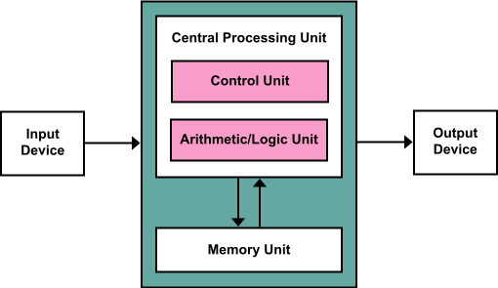
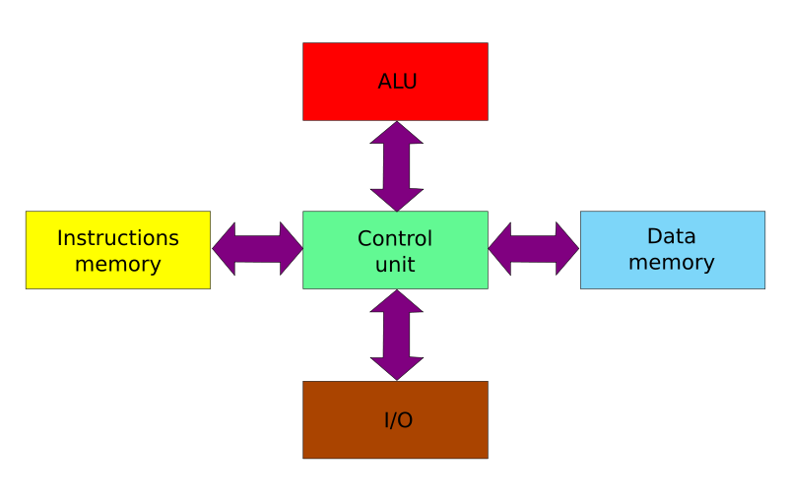
Von Neumann Architecture 冯诺依曼结构
1.Five components partitioning
Input 输入
Output 输出
Memory 存储器
ALU 算术逻辑单元
Control unit 控制单元
2. Three key concepts:
Both instructions and data are stored in a single read-write memory
The contents of memory are addressable by location, without regard to the type of data
Execution occurs in a sequential fashion
I/O devices
Memory
CPU
Harvard architecture
Notes:
Derived from a 1945 computer architecture description by John von Neumann and others.
Q: How did he get this idea?
A: From Alan Turing’s paper of 1936 in which he described a hypothetical machine called “universal computing machine”(now known as the “universal Turing machine”). Turing was a PHD student at the Institute for Advanced Study in Princeton during 1936-1937. von Neumann was involved in Manhattan Project which require huge amounts of calculation. This drew him to the design of stored-program computer, the EDVAC, together with J. Presper Eckert and John Mauchly.

Slide 5
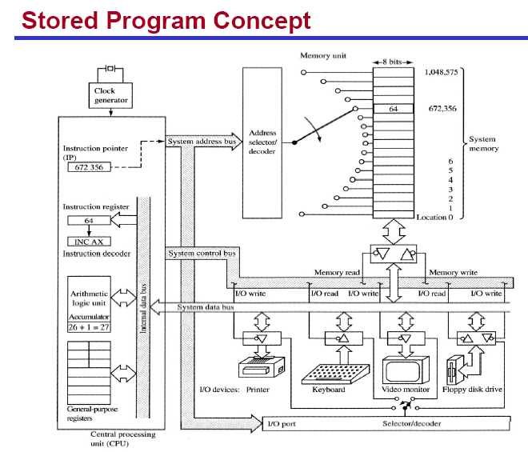
Notes:
Both Von Neumann architecture (or Princeton architecture) and Harvard architecture are stored-program computers.
Q:What’s the problem with the Princeton architecture?
A:an instruction fetch and a data operation cannot occur at the same time because they share a common bus (which is referred to as the Von Neumann bottleneck and limits the performance of the system)

Slide 6
Microprocessor 微处理器
Microprocessors
the CPU circuitry can been reduced to IC (Integrated Circuit) scale, consisting of ALU, CU and registers
contains no RAM, ROM, or I/O ports on the chip itself
e.g., Intel’s x86 family (8088, 8086, 80386, 80386, 80486, Pentium); Motorola’s 680x0 family (68000, 68010, 68020, etc)

Slide 7
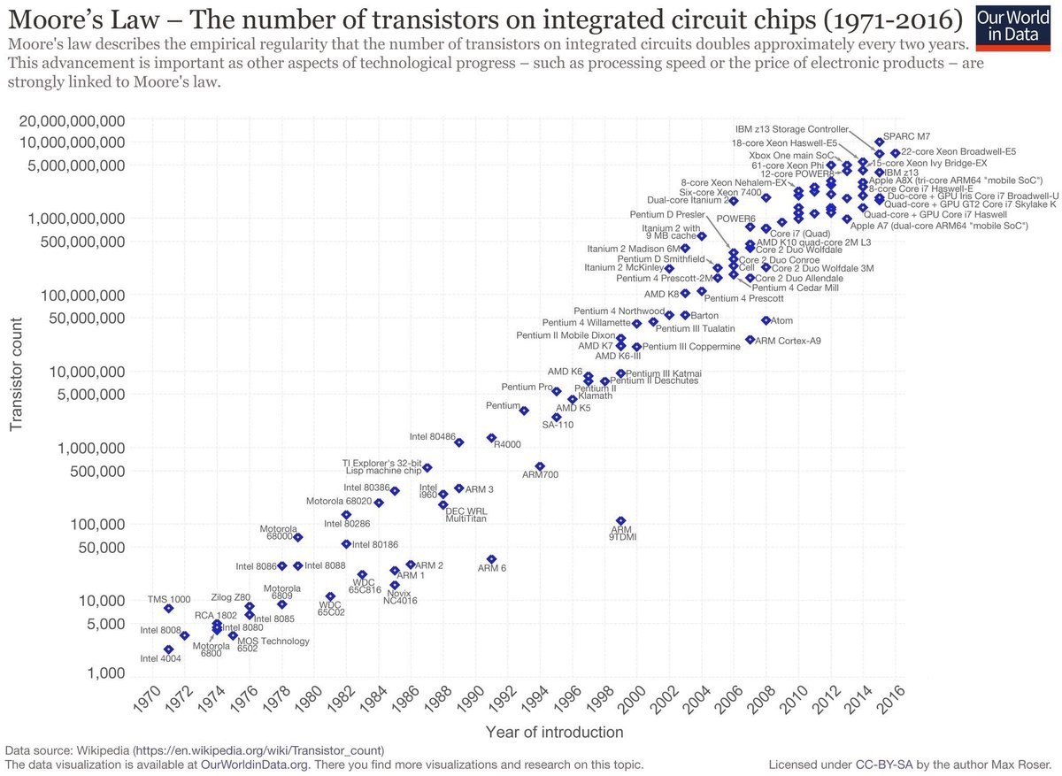
Notes:
Moore’s law is the observation that over the history of computing hardware, the number of transistors on integrated circuits doubles approximately every two years. The law is named after Intel co-founder Gordon E. Moore, who described the trend in his 1965 paper.

Slide 8
Microcomputer 微型计算机
CPU: processes information stored in the memory
Microprocessor
Memory: stores both instructions and data
ROM, RAM
Input/Output ports, I/O接口: provide a means of communicating with the CPU
Connecting I/O devices, e.g., keyboard, monitor, tape, disk, printer and etc.
BUS 总线: interconnecting all parts together
Address bus
Data bus
Control bus

Slide 9
Microcomputer Structure
Address bus
I/O
ports
I/O
devices
Memory
CPU
Data bus
Control bus

Slide 10
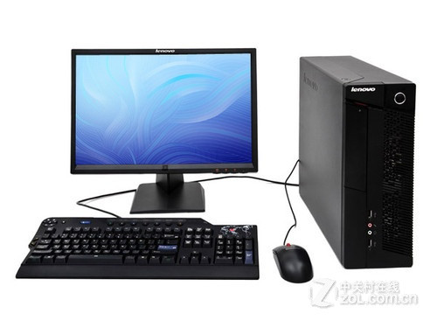
Microcomputer System
Microcomputer
Peripheral I/O devices
Software
System software
e.g., OS, compilers, drivers
Application software
e.g. Word, MatLab, Media player, Latex…

Slide 11
Microcomputer System Structure

Slide 12
Hardware: CPU (1) - ALU
Arithmetic Logic Unit (ALU)
Arithmetic functions: add, subtract, multiply and divide
Logic functions: AND, OR, and NOT
ALU is a multifunctional calculator
What specific calculation will be taken depends on the particular control signal
Two inputs
Calculation result can be temporarily stored in one of the registers
Input
Input
control
signal
ALU
results

Slide 13
Hardware: CPU (2) - CU
Control Unit works under instructions 指令
An instruction is a pre-defined code which defines a specific operation, processing and exchanging information among CPU, memory and I/O devices.
CU contains an instruction decoder 指令解码器
decodes an instruction and generates all control signals, coordinating all activities within the computer
CU contains a program counter 程序计数器
points to the address of the next instruction to be executed

Slide 14

Hardware: CPU (3) – Instruction Set
The instruction set 指令集
All recognizable instructions by the instruction decoder
CISC (Complex Instruction Set Computers)
Variable instruction length (1 word- n words)
Variable execution time of different format instructions
More instruction formats
Upwardly compatible (new instruction set contains earlier generation’s instructions)
e.g., 80x86 family has more than 3000 instructions
RISC (Reduced Instruction Set Computers)
Fixed size (1 word)
Fixed time for all instructions
Easy to pipeline the RISC instructions (fast)
Fewer formats (simple hardware, shorter design cycle)
e.g., PowerPC, MIPS, ARM, PIC’s MCU

Slide 15
Hardware: Memory
Memory hierarchy
Registers
Cache
Primary memory: ROM, RAM
Secondary memory: magnetic disk, optical memory, tape, …
Notes:
Why hierarchy? What is its goal? Why does it work?

Slide 16
Hardware: Memory
Bit (b): a binary digit that can have the value 0 or 1
Byte (B): consists of 8 bits
smallest unit that can be addressed in microcomputers
Nibble: is half a byte (4bits)
Word, 字: the maximum number of bits that a CPU can process at one time
depends on the width of the CPU’s registers and that of the data bus
e.g., if the width of the data bus is 16 bits, then a word is 16 bits; if the width of the data bus is 32 bits, then a word is 32 bits
Double word, 双字
Kilo, Mega, Giga, Tera, Peta, …
1 0 1 0 1 0 1 0
Notes:
Q:Why binary?
A:it is a electronic computer and it is natural to use high and low voltages to represent data.

Slide 17
Memory Module Organization
To organize a memory module with given memory chips
8-bit
16-bit
32-bit
To organize a memory module：
If the module needs bigger unit of transfer than that of given memory chips, bit extension
If the module needs larger number of words than that of given memory chips, word extension
Notes:
不同字长存储器的地址安排
16位时同一行两个字节地址的最低1位不同
32位时同一行4个字节地址的最低2位不同

Slide 18
Hardware: Bus
A bus is a communication pathway connecting two or more devices
A shared transmission medium: so one device at a time
System bus: connects major computer components (processor, memory, I/O)
Arbitration, 仲裁 ?
Distributed protocols
e.g., CSMA/CD in Ethernet
Centralized scheme:
Master/Slave
Master activates a bus
Slave passively waits for the Master's commands

Slide 19
Hardware: Bus
Type
Dedicated (e.g., physical dedication)/Multiplexed (e.g., time multiplexing)
Arbitration
Centralized: bus controller responsible for allocating time on a bus
Distributed: each module has access control logic and collaborate
Timing
Synchronous: events on the bus is determined by a global clock, a single 1-0 transmission is referred to as a bus cycle
Asynchronous: devices have their own clocks and communicate before and after an event

Slide 20
Single-bus Structure
AB
IO device
CPU
RAM
ROM
I/O ports
IO device
DB
CB
A bus connects all modules
pro：simple
con：poor performance in terms of throughput
Why
Notes:
单总线分解为地址总线、数据总线和控制总线

Slide 21
CPU-Central Dual-Bus Structure
I/O bus
CPU
I/O ports
I/O ports
I/O ports
Memory bus
Memory
IO device
IO device
IO device
A dedicated bus between CPU and memory, and a dedicated bus between CPU and I/O devices
pro：efficient in terms of data transfer
con：information between memory and I/O devices has to go through CPU. Therefore, poor CPU performance
Notes:
CPU-存储器总线
CPU-I/O总线

Slide 22
Memory-Central Dual-Bus Structure
I/O bus
Memory
I/O port
I/O port
CPU
Memory bus
IO device
IO device
Gain both High CPU performance and data transfer throughput
Notes:
主存也与I/O总线连接

Slide 23
Hardware: BUS (1) – Data Bus
Used to provide a path for moving data between system modules
Bidirectional
CPU read: Memory (I/O device) -> CPU
CPU write: CPU -> Memory (I/O device)
The width of data bus
is as wide as the registers of a CPU (i.e. the width of a word)
determines how much data the processor can read or write in one memory or I/O cycle
Which also defines a word of this computer

Slide 24
Hardware: BUS (2) - Address Bus
Used to designate the source or destination of the data on the address bus that the processor intends to communicate with
Unidirectional
CPU → memory or I/O devices
The width of the address bus, n
determines the total number of memory locations addressable by a given CPU, which is 2^{n}
e.g., 8086 has a 20-bit address bus which corresponds to 2²⁰ addresses or 1M (1 Meg) addresses or memory locations;
Pentium has 32-bit address bus, what is the size of its addressable memory?
How to calculate the capacity (size) of memory that a CPU can support then?

Slide 25
Hardware: BUS (3) – Control Bus
Used to control each module and the use of data and address buses
Command and timing information between modules
e.g., memory read/write, IO read/write, Bus request/grant
Consists of two sets of unidirectional control signals
Command signal: CPU → Memory (I/O device)
State signal: Memory (I/O device) → CPU
Input/Output is defined from the processor’s point of view
e.g., when Memory (I/O device) Read is active, data is input to the processor

Slide 26
Addressing Schemes 寻址方式
Memory-mapped I/O, 存储器映像寻址方式
One single address space for both memory and I/O
Status and data registers of I/O modules are treated as memory locations
Using the same machine instructions to access both
e.g., ARM
Isolated I/O, I/O单独编址方式
Two separate address spaces for memory and I/O modules
Using different sets of accessing instructions
e.g., Intel 8086
Notes:
It is about how memory and I/O are associated with addresses.

Slide 27
Memory-mapped I/O

Slide 28
Isolated I/O
Dedicated address lines
Multiplexing address lines
What is the essential difference between the memory-mapped and isolated I/O addressing schemes?
Notes:
Whether the CPU is aware of the type of object being accessed.

Slide 29
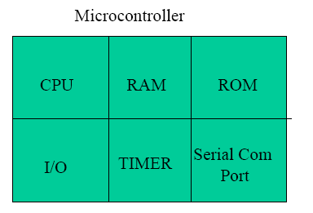
Microcontrollers (MCS) 微控制器
A microcontroller has a CPU in addition to a fixed amount of RAM, ROM, I/O ports on one single chip
Ideal for applications in which cost and space are critical
Example: a TV remote control does not need the computing power of a 486

Slide 30
Embedded Systems 嵌入式系统
An embedded system uses a microcontroller or a microprocessor to do one task and one task only
Example: toys, TV remote, keyless entry, etc.
Using microcontrollers is cheap but sometimes inadequate for the task
Microcontrollers differ in terms of their RAM,ROM, I/O sizes and type.
ROM (often used as program memory, like BIOS)
OTP (One Time-Programmable)
UV-ROM, EEPROM
Flash memory
RAM (can be used as both program mem and data mem)
SRAM(static RAM):cache
DRAM(Dynamic RAM): main memory
SDRAM (Synchrous DRAM)
DDR DRAM (Double Data Rate DRAM)
DDRII

Slide 31
Assignment One
Go Jbox/Canvas site and download the Assignment One
https://jbox.sjtu.edu.cn/l/5odWhf (Password:EI209)
https://oc.sjtu.edu.cn
Due on April 27.

